Slide 1
Chapter 6: Enhanced Control (Cascade, FF, SP)
Chapter 6: Enhanced Control (Cascade, FF,)
EE4265 Tutorial Solutions

Slide 2
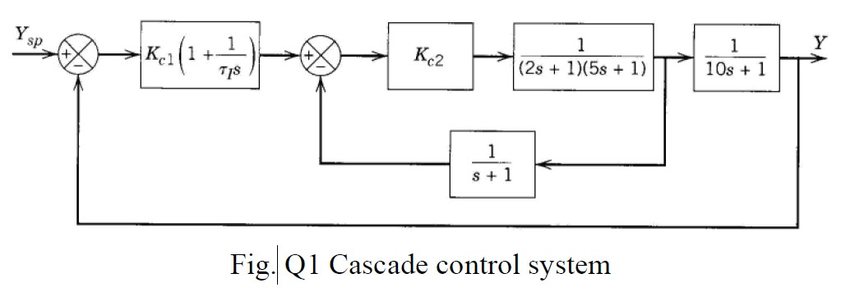
Q1(a ) - Specify the Inner open loop
The open loop transfer function of the inner loop is,

Slide 3
Q1(a ) - Find
Kc2
by trial and error
When Kc2 = 5.3 , the gain margin and phase margin are,
GM = 7.52dB
PM = 30.7◦

Slide 4
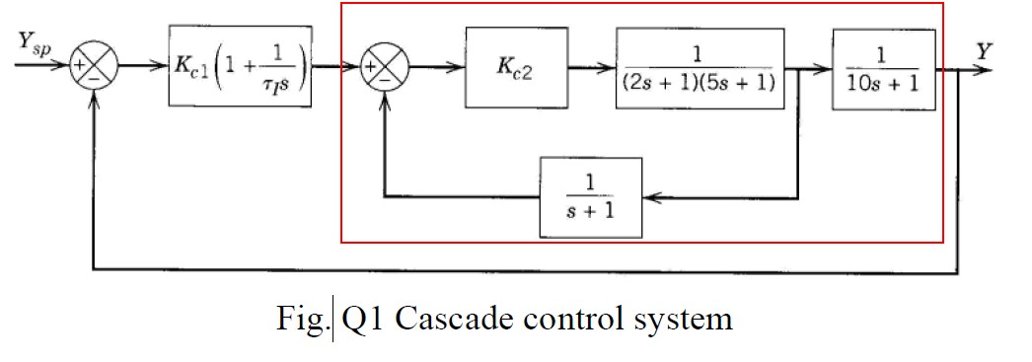
Q1(b ) - Specify the overall process
The Inner closed loop is,
g ^{inner}
Kc2 (s + 1)
cl
(s ) =
(s + 1) (2s + 1) (5s + 1) + K
c2
The overall process transfer function for the outer loop is,
g ^{outer} (s ) =
Kc2 (s + 1)
1
(s + 1) (2s + 1) (5s + 1) + K_{c2} × 10s + 1

Slide 5
Q1(b ) - Tuning the outer loop by ZN ultimate gain,
ultimate period method
Kc2 (s + 1)
1
g ^{outer} (s ) =
(s + 1) (2s + 1) (5s + 1) + K_{c2} × 10s + 1
1
Gain margin & Critical Frequency of g ^{outer} (s ) can be found using the matlab command,
2
GM in Amplitude ratio = 3.2490 = Ku (ultimate gain )

Slide 6
Q1(b ) - Tuning the outer loop by ZN ultimate gain,
ultimate period method

Slide 7
Q1(b ) - Studying the Tracking Response

Slide 8
Q1(b ) - Studying the Disturbance Rejection Response

Slide 9
Q1 - Code used
1
2
3
4
5
6
7
8
9
10
11
12
13
14
clc
clear all close all
%% the inner open loop s=tf(’s’);
gol_inner =5.3/((2* s +1) *(5* s +1) *(s +1) );
%% bode of inner open loop
figure (’ position ’ ,[100 100 1024 768]) ;
margin ( gol_inner )
%% bode of outer loop ’s process gouter_process =(s +1) * feedback ( gol_inner ,1)
*1/(10* s +1) ;
[Ku PM wc ]= margin ( gouter_process );
%% ZN controller pu =2* pi/wc;
tau_i =pu /1.2;
gc =0.45* Ku *(1+1/( tau_i *s));
%% tracking response
gcl2 = feedback (gc* gouter_process ,1) ; figure (’ position ’ ,[100 100 1024 768]) ; step ( gcl2 ); title (’ Tracking Response ’)
%% disturbance rejection response figure (’ position ’ ,[100 100 1024 768]) ; step (1 - gcl2 ); title (’ Disturbance Rejection
Response ’)
15
16
17
18
19
20
21
22
23
24
25
26
27
28
29

Slide 10
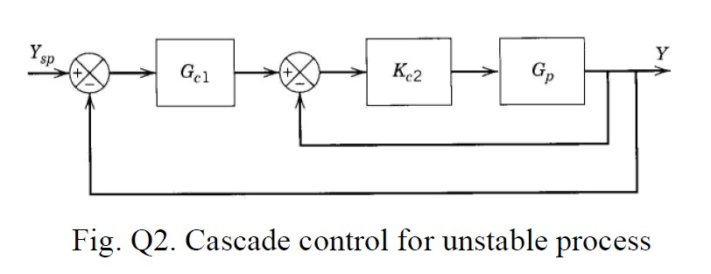
Q2(a ) - Find
Kc2
Inner closed loop is,
Kc2Gp
s +1
^{Kc2} s −3
Kc2 (s + 1)
g ^{inner}
(8 ) =
=
=
cl
1 + K G
1 + Kc2 ^{s +1}
8 − 3 + K (s + 1)
c2 p
^{s} −³
c2
Kc2 (s + 1)
=
(1 + Kc2) s + (Kc2 − 3)
Condition for stability is,
Kc2 > 3

Slide 11
Q2(b ) - Find PI controller
Inner loop when Kc2 = 6 is,
K_{c2} (s + 1)
g ^{inner}
6 (s + 1)
cl
(s ) =
=
(1 + K ) s + (K
− 3) 7s + 3
c2
c2
Overall closed loop is,

Slide 12
Q2(b ) - Find PI controller
Closed loop characteristic equation is,
which is simplified to,
Objective: Find K_{c} and τ_{i} so that closed loop characteristic
equation is,
(s + 0.5 − 0.2j ) (s + 0.5 + 0.2j ) = 0
s ² + s + 0.29 = 0
Answer:
K_{c} = 1.1322
τ_{i} = 1.6983

Slide 13
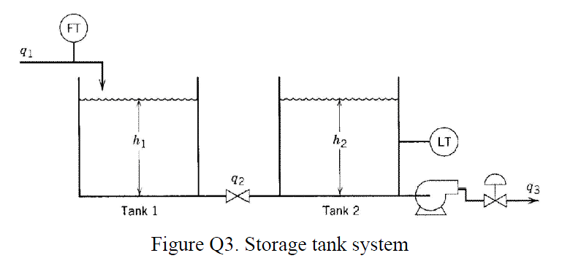
Q3 - Feed forward control
Given data:
1
h2 must be regulated (there should be no variations in h2).
q₁ is the disturbance variable.
q₃ is the manipulated variable, it is independent of h₂.
q₂ is the flow between the tanks and depends on h₁ and h₂.
2
3
4

Slide 14
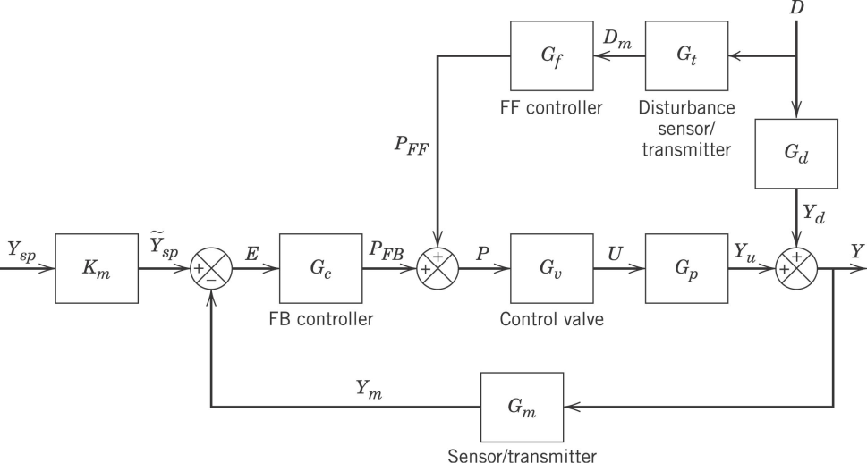
Q3 -a block diagram.
Y=H₂, D=Q₁, and U=Q₃.

Slide 15
Q3 -b Derive the mass balance at steady state.
A steady-state mass balance on both tanks gives
(in deviation variables)
From the block diagram, at steady state:
result

Slide 16
Q3(c) - Case when q₂ =
when t FF design remain the same as at steady state
and
remain the same
6

Slide 17
Q4 -a
The answer is A.
Why? The objective of feedforward control is to compensate to disturbance before the process can be affected. The manipulated stream subject to 3 seconds time delay. For effective FF control, disturbance measurement must be obtained with enough time to allow the delayed manipulated stream to compensate.

Slide 18
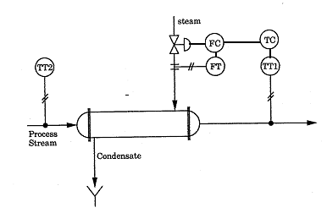
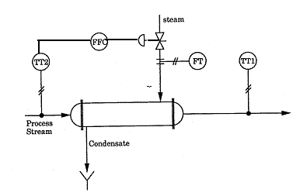
Q4 -b
Feedforward control Cascade Control

Slide 19
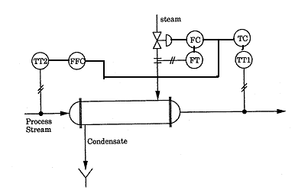
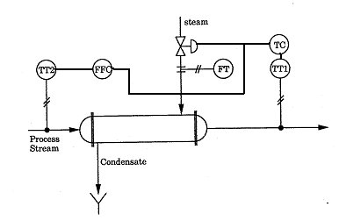
Q4 -b
Feedforward/feedback Feedfroward/feedback/cascade

